Slide 1
THE AMISH MINI DOCUMENTARY MADE IN AMERICA
MARA VOORTMAN

Slide 2
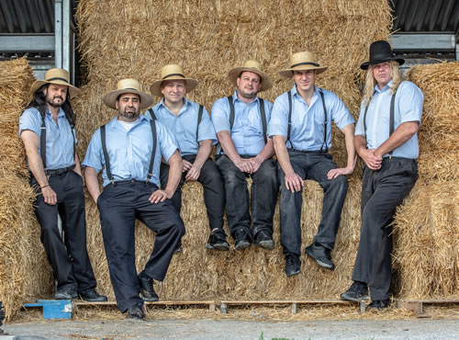

OUR THEME
Religion in America
The Amish
The start of the research

Slide 3
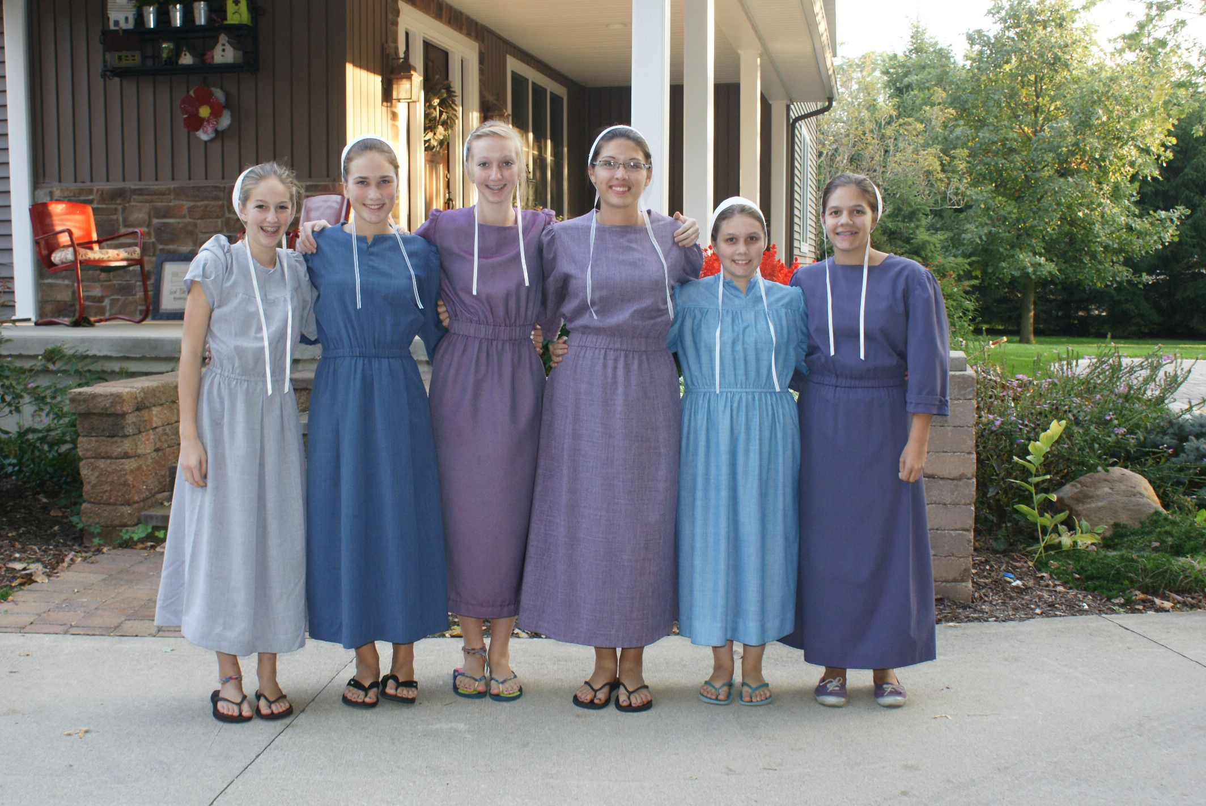
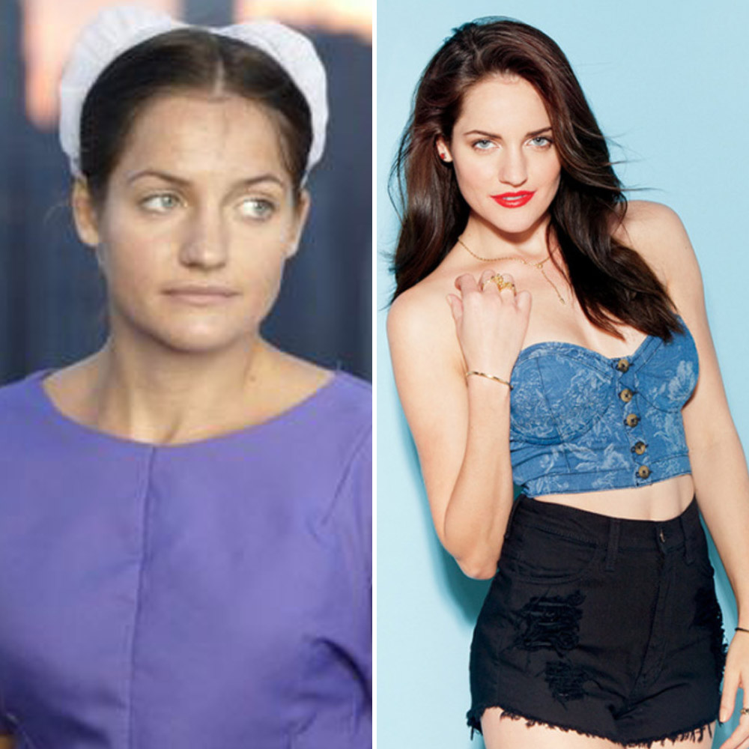
WHAT DID WE WANT TO KNOW
The basics
Predictable information
New information
1.
2.
3.

Slide 4
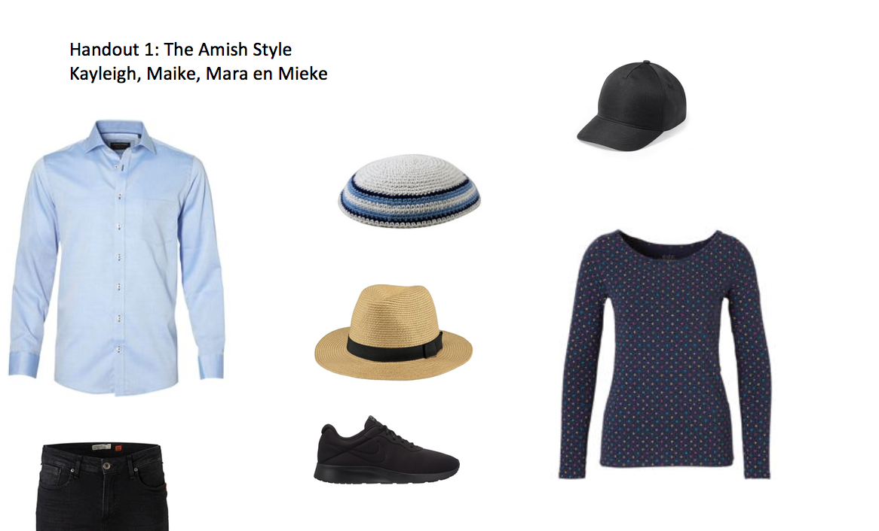
THE HANDOUT
Dress your Amish
“What clothes belong to the Amish culture?”

Slide 5

IN THE CLASSROOM
Objective view on religion
Fun handout

